Slide 1
Information Management Assignment 5

Slide 2
Question 1
a) The graph is disconnected:
If the graph representing the E-R diagram is disconnected, it means that there are multiple isolated components or clusters within the schema. Each component represents a subset of entities and relationships that are not connected to other components.
In the context of an enterprise schema, this could indicate separate or independent parts of the schema that do not interact or have relationships with each other. It might suggest different functional areas or departments within the enterprise that have distinct sets of entities and relationships.
b) The graph has a cycle:
If the graph representing the E-R diagram has a cycle, it means that there is a circular dependency among the entities or relationships in the schema. In other words, it's possible to traverse a path through the entities and relationships and return to the starting point without repeating any nodes.
In the context of an enterprise schema, a cycle could indicate a recursive relationship or dependency between entities. For example, if entity A is related to entity B, which in turn is related back to entity A, it forms a cycle. This could represent relationships such as "employee manages department" and "department is managed by employee", creating a circular dependency. Depending on the specifics, cycles might need to be carefully managed to avoid data integrity issues.

Slide 3
Question 3
They enhance conceptual modeling by accurately representing real-world scenarios where entities depend on others for their identification, ensuring that the model faithfully reflects the complexities of the domain being modeled. Additionally, by explicitly representing the dependency of weak entities on strong entities, database designers can enforce referential integrity constraints, maintaining data consistency and preventing orphaned records.
The explicit representation of weak entity sets simplifies querying by providing clear relationships between entities, enabling developers to write queries more efficiently and understand the dependencies between entities

Slide 4
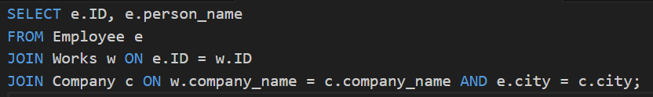
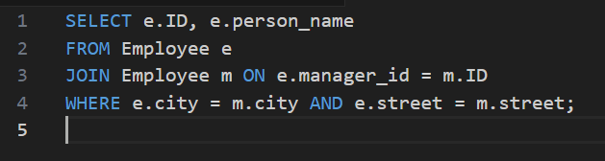
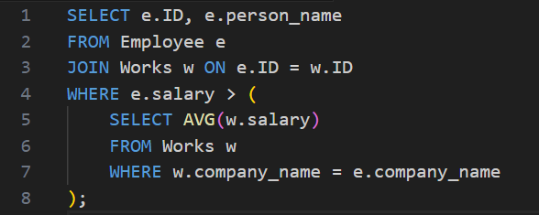
Question 4a

Slide 5

Question 4b
The problem with NATURAL JOIN is that it can lead to unintended consequences, especially when there are multiple columns with the same name across tables, which is common in larger databases. In this case, using NATURAL JOIN without specifying the join conditions explicitly could result in unexpected matches and might not produce the desired result.

